Slide 1

BIG DATA TOOLS FOR MANAGERS
Unit-2 : Data Retrieval using MySQL
by
Ankit Velani
Adjunct Faculty, Dept. of MBA,
Siddaganga Institute of Technology,Tumkur

Slide 2
Data
Data is a collection of a small piece of information. It can be used in a variety of forms like text, numbers, media, bytes…etc
i.e. Student data, Employee data, Events data, Travelling data

Slide 3
Database
A database is an organized collection of data so that it can be easily managed and accessible.
Student data
Employee data
Event data
Database
Movies data
Exam data
Sports data

Slide 4
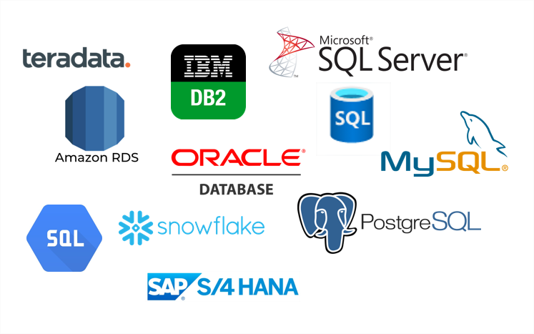
DBMS
Data Base Management System is software used to store and retrieve the database.

Slide 5
RDBMS
Relational Data Base Management System
All the modern database systems like MySQL, ORACLE…etc are based on RDBMS.
In RDBMS, data are stored in form of Tables, and it allows to create relationships between tables.

Slide 6
RDBMS
Emp_ID | ENAME | POST | CITY
E1 | John | Manager | USA
E2 | Nick | Data Analyst | UK
E3 | Dom | Product Owner | UK
E4 | Paul | Project Owner | UK

Slide 7
RDBMS
Columns/ Attributes/ Fields
Emp_ID | ENAME | POST | CITY
E1 | John | Manager | USA
E2 | Nick | Data Analyst | UK
E3 | Dom | Product Owner | UK
E4 | Paul | Project Owner | UK
Records/
Tuples/
Rows

Slide 8
Table Creation
CREATE TABLE table_name (
col-name-1 data-type
col-name-2 data-type,
col-name-3 data-type,
col-name-4 data-type
);

Slide 9
Table Creation
CREATE TABLE table_name (
col-name-1 data-type
col-name-2 data-type,
col-name-3 data-type,
col-name-4 data-type
);
CREATE TABLE employee (
emp_id text,
ename text,
post text,
city text
);

Slide 10
Insert Records/Rows
INSERT INTO table_name VALUES (‘value-1’, ‘value-2’,……);
INSERT INTO employee VALUES ( ‘E1’,
‘John’,
‘Manager’,
‘USA’
);

Slide 11
Retrieve Data using SELECT
SELECT * FROM table_name;
(asterisk) represent all the columns
from table

Slide 12
Retrieve Data using SELECT
SELECT * FROM table_name;
SELECT * FROM employee;
SELECT ename FROM employee;
SELECT ename, city FROM employee;

Slide 13
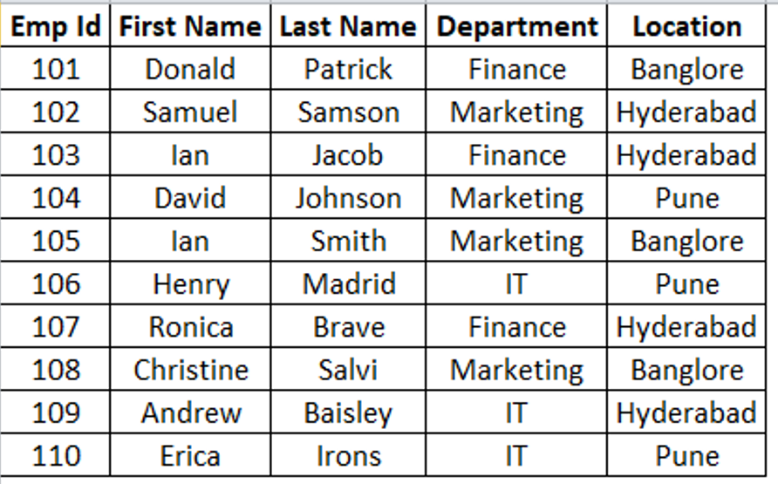
Create Employee_2 table in SQL

